Slide 1
The Golden Circle
An Online Contact Manager for Exclusive Circles

Slide 2
Meet the Team
Gabriel Alves - Database/ Front End/ API
Wyatt Fogel - Front End
Ivan Miskevich - API
Ryan Schlosbon - Project Manager/ Front End

Slide 3
Framework and Tech
Stack - LAMP (Linux, Apache, MySQL, PHP)
Frontend - HTML, CSS, JavaScript
Database - MySQL
API - PHP
Hosting - DigitalOcean and GoDaddy
Communications - Discord

Slide 4
What Went Well
What Didn’t
Accountability and Initiative
Postman/ Swaggerhub
Comradery
Communication
Time Management
Responsive Sizing

Slide 5
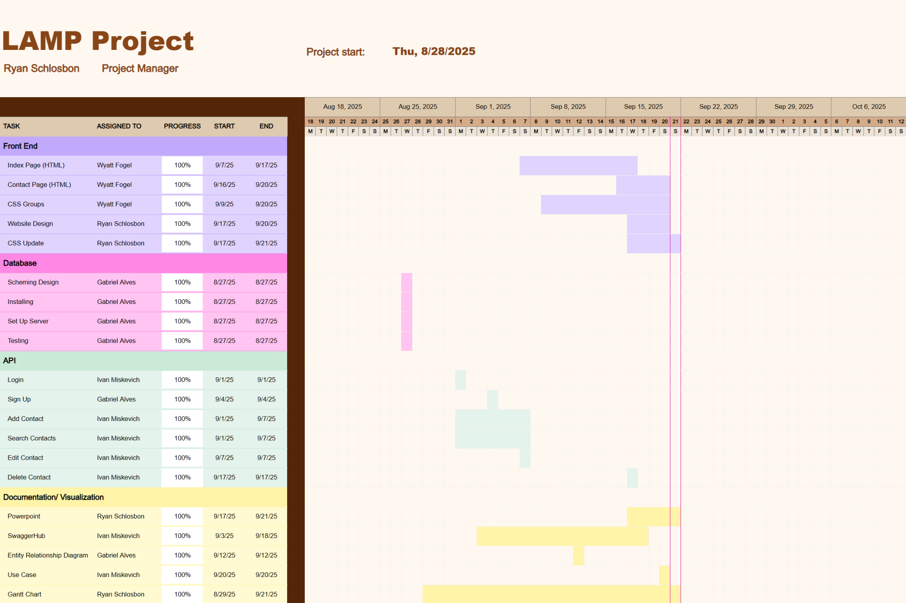
Gantt Chart

Slide 6
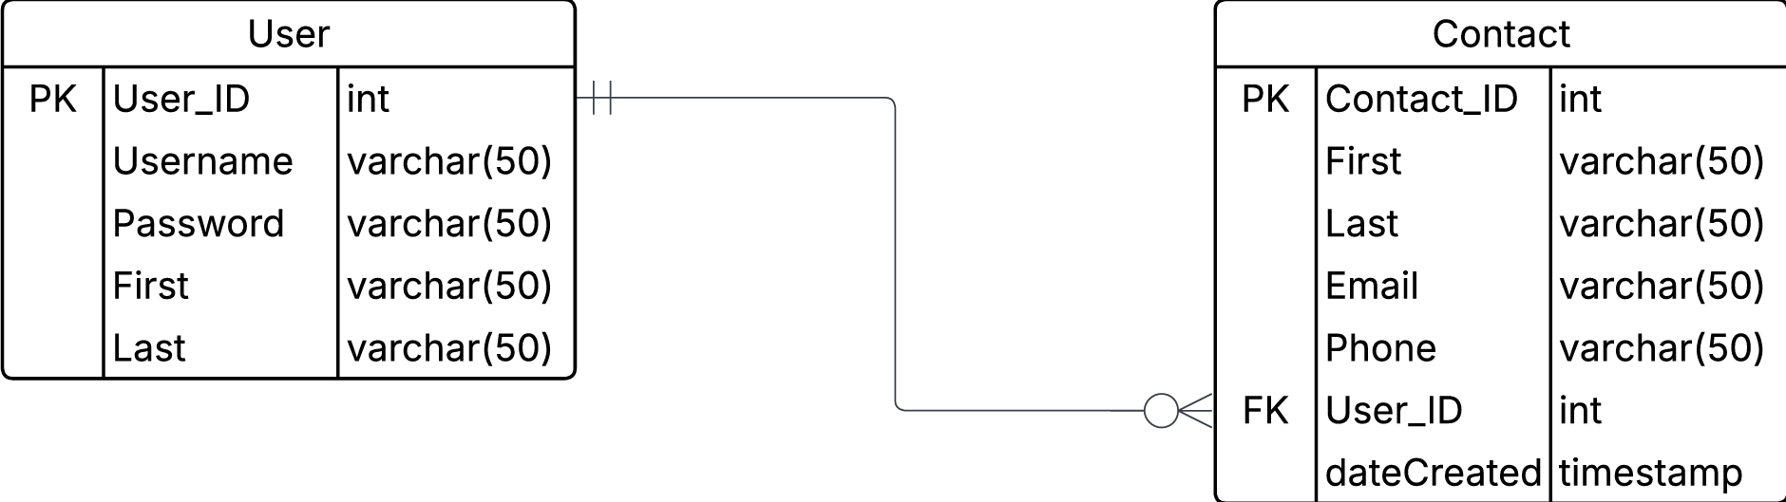
Entity Relationship Diagram

Slide 7
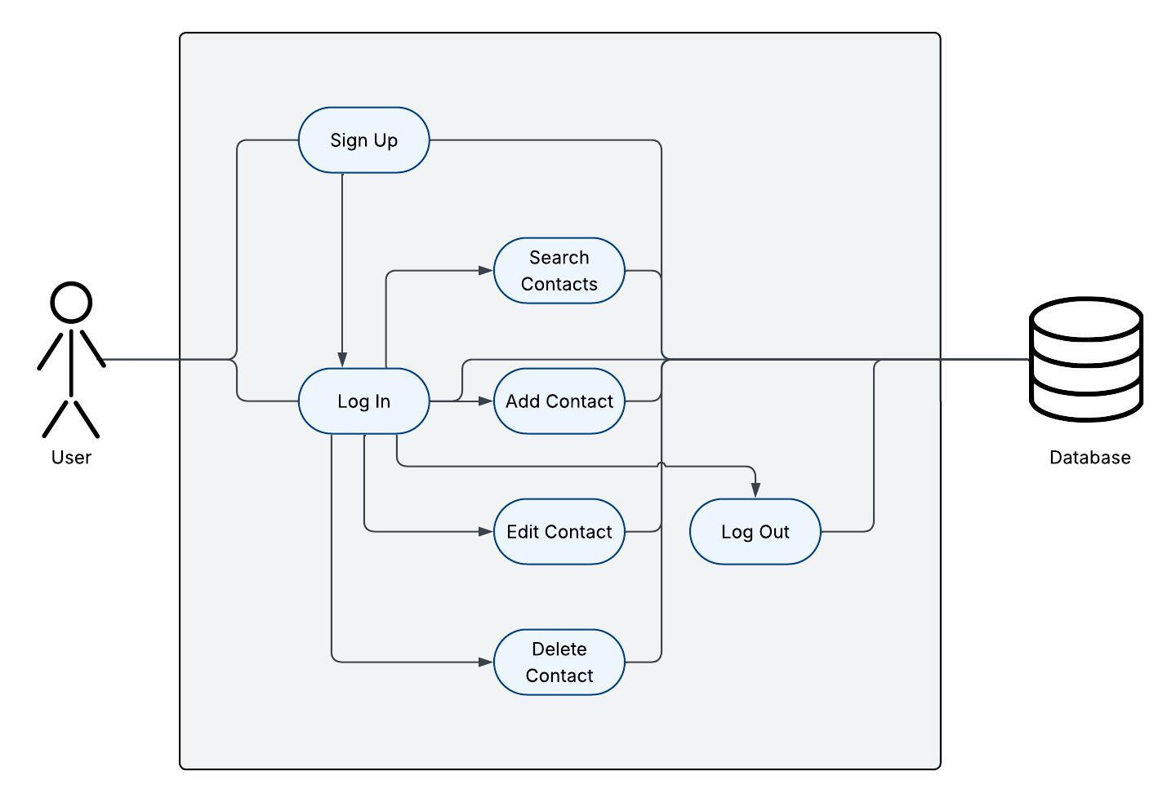
Use Case Diagram

Slide 8
API Demo
Video: Google Drive Link
Documentation: Swaggerhub Link
API’s testing: SearchContact, AddContact

Slide 9
Website Demo
http://thegoldencircle.online/
Notes:
I recommend that we record a video of us using the site so in case something goes terribly wrong, we can play the video here to show it working and connected.

Slide 10
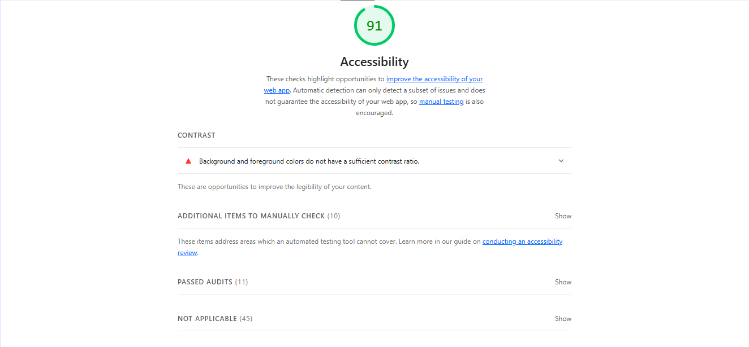
Lighthouse Report

Slide 11
Questions?

